Slide 1

Bottle Rockets Day 1
MIT STEAM Camp 2019

Slide 2

The Beginning of the Rocket
Though exact origin is unclear, first version of rocket is believed to be invented 1232
What did it look like
Bamboo tube filled with gunpowder
Tube attached to arrows
During the battle of Kai-Keng, the “arrows of flying fire” were used
Notes:
https://www.grc.nasa.gov/WWW/k-12/TRC/Rockets/history_of_rockets.html

Slide 3
Brief Rocket Timeline
1591 - First Multi Staged Rocket - German fireworks maker Johann Schmidlap reaches new heights
1792 - Rocket Revival - Rockets are designed for military use by British after they are used by Indians against the British
1942 - V-2 Rockets - German engineers build world’s first long range missile
1957 - First Satellite - Soviet Union launched Sputnik
1961 - First Man to Orbit Earth - Russian Yuri Gagarin
1969 - Moon Landing - Neil Armstrong first walks on moon
1981 - First Space Shuttle - Reusable vehicles that increase accessibility to orbit
2000+ - Ongoing Space Explorations - Countries and Organizations continue to send probes and make plans: Japan, European Space Agency, India, China, Russia, USA
Notes:
https://www.sciencelearn.org.nz/concepts

Slide 4

What even is a Rocket?

Slide 5
Rocket
The word "rocket" can mean different things.
A tall, thin, round vehicle
Something that launches into space
A type of engine
A vehicle that uses a “rocket” engine
A projectile
Notes:
https://www.nasa.gov/audience/forstudents/k-4/stories/nasa-knows/what-is-a-rocket-k4.html

Slide 6
Projectile
Any object launched with an initial force
What do you notice about the path, or trajectory the objects follow?
Notes:
Throw balls around and ask what they notice about it

Slide 7
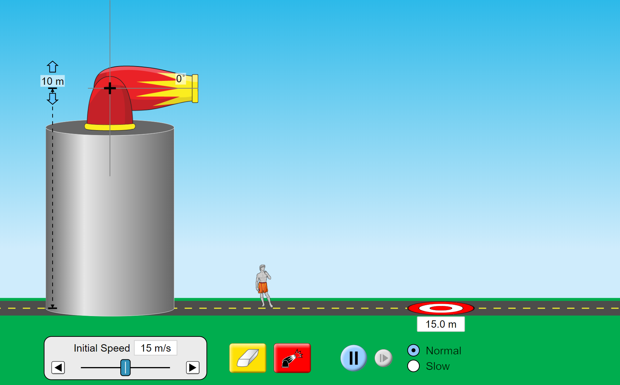
Projectile Motion Simulator
Notes:
https://phet.colorado.edu/sims/html/projectile-motion/latest/projectile-motion_en.html

Slide 8
Discussion
What happened when you changed
Launch Height
Launch Angle
Initial Speed
Mass

Slide 9
Stomp Rockets
Work in pairs to build a paper rocket that travels the furthest distance
INSERT STOMP ROCKET SETUP

Slide 10
Stomp Rocket
What did you notice about your rocket?
What was easy?
What was hard?
What would you change if you were to do the activity again?

Slide 11
Bottle Rockets
Work in pairs to design a bottle rocket that will work in the pictured setup
Think about what you learned from the stomp rocket activity
INSERT Botle ROCKET SETUP

Slide 12
Bottle Rockets
What was different about the bottle rockets when compared to the stomp rockets?
What was unexpected?
What would you change if you were to do it again?

